Slide 1
Light Account Next steps
Topics
Overview
Next Steps
Benefits
Upgrade
Help
FAQ

Slide 2
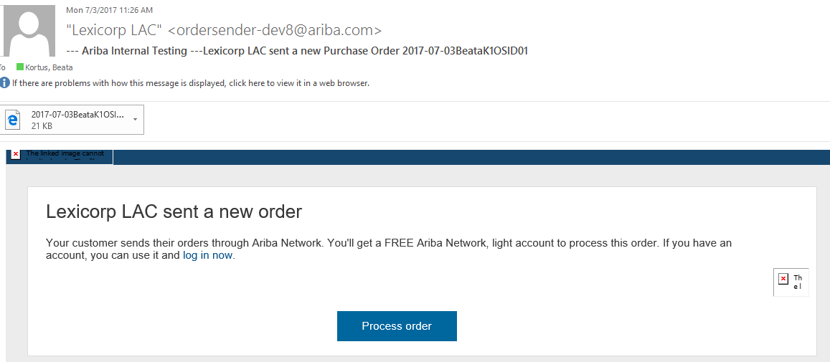
Next Steps- Sign-up for Light Account from order
Topics
Click on on Process Order button in the PO notification letter
Overview
Next Steps
Benefits
Upgrade
Help
FAQ

Slide 3
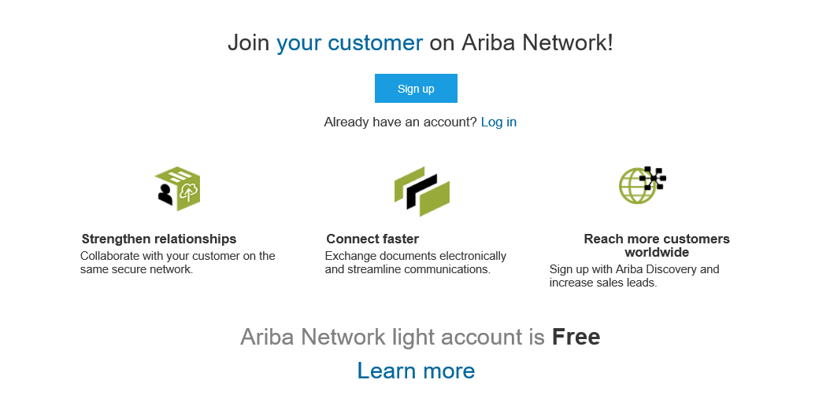
Next Steps- Sign-up for Light Account from order
Topics
Select the Sign up option to create your Light Account and exchange documents free of charge on Ariba or use your existing account by clicking on Log In link
Overview
Next Steps
Benefits
Upgrade
Help
FAQ

Slide 4
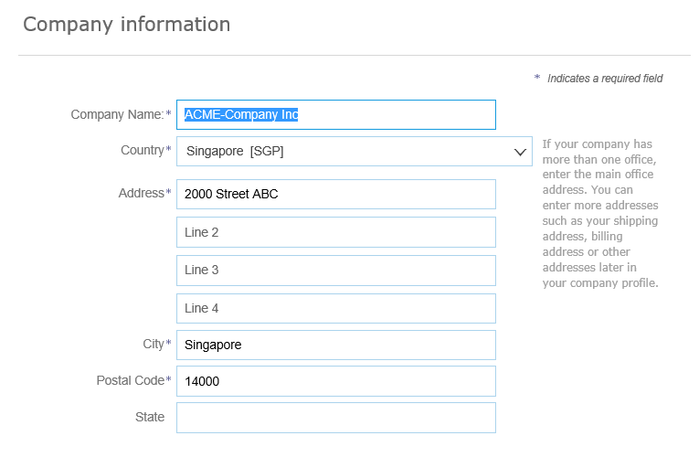
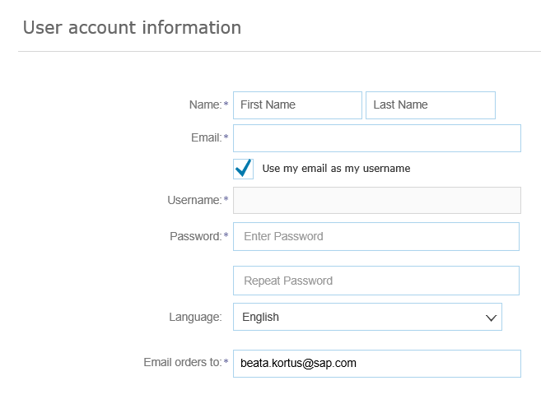
Next Steps- Sign-up for Light Account from order
Topics
Review your Company information
Enter your User account information
Overview
Next Steps
Benefits
Upgrade
Accept Terms of Use and click on Register
Help
FAQ

Slide 5
Next Steps- Sign-up for Light Account from order
Topics
Click on Create Invoice button to start working on the invoice. If you need assistance please refer to the articles in help section (right hand side).
We recommend How to create a PO-based invoice video
Overview
Next Steps
Benefits
Upgrade
Help
FAQ

