Slide 1
IT Contractor Management
Mosaic Contractors Fieldglass Transition

Slide 2
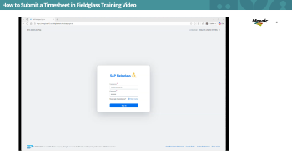
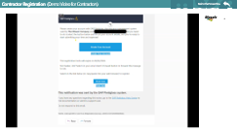
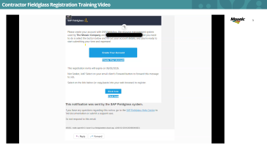
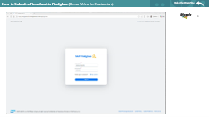
Timesheets must now be submitted in Fieldglass
Timesheets must be submitted in Fieldglass by Mondays at noon EST.
Mosaic Hiring Managers will approve by Tuesdays at noon EST.
If timesheet is rejected, please resubmit timesheet with correct hours.
All overtime and holiday hours should be pre-approved by Mosaic manager.
Step-by-step videos are available showing how to:
• Register to Fieldglass
• Submit your timesheet
?
Questions?
Please direct any questions to your supplier representative.

Slide 3
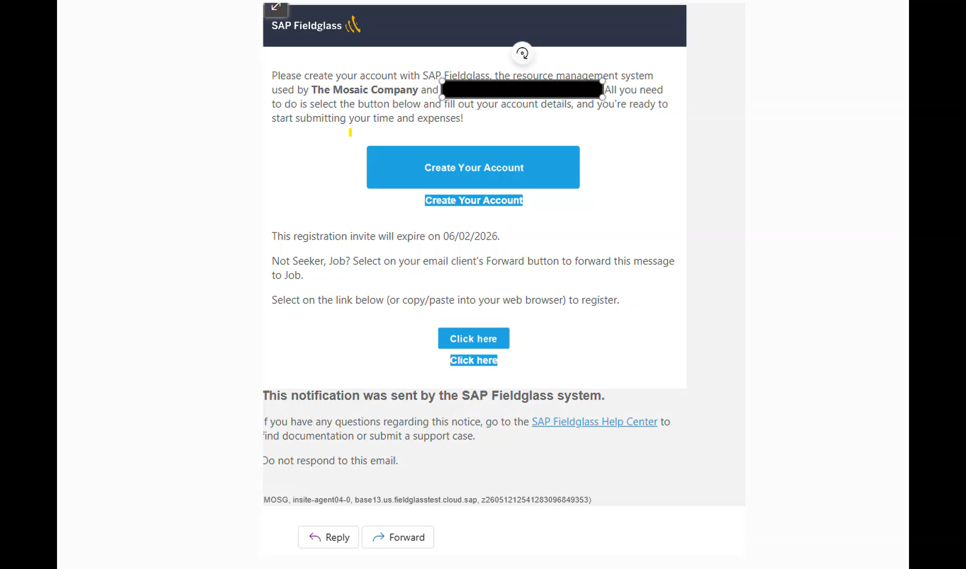
Contractor Fieldglass Registration Training Video

Slide 4
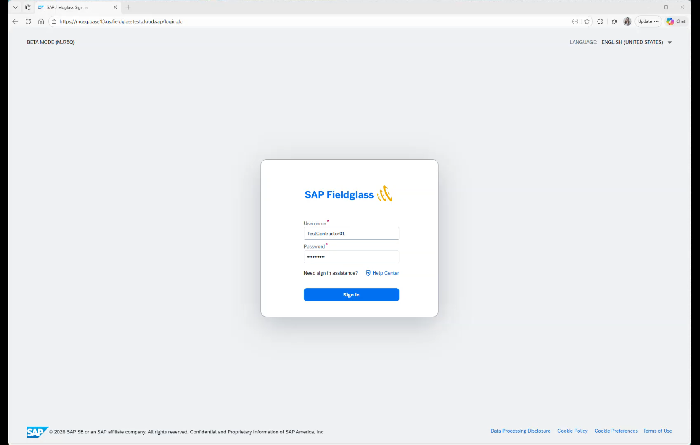
How to Submit a Timesheet in Fieldglass Training Video

Slide 5
Thank you!

