Slide 1
IT Contractor Management
Mosaic Supplier Fieldglass Training: Contingent

Slide 2
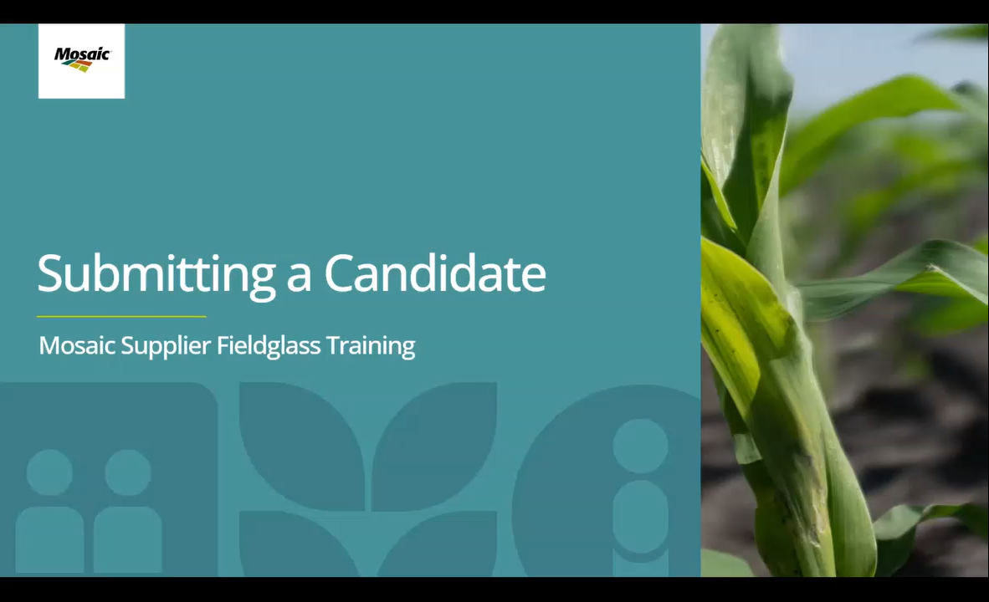
Submitting a Candidate

Slide 3
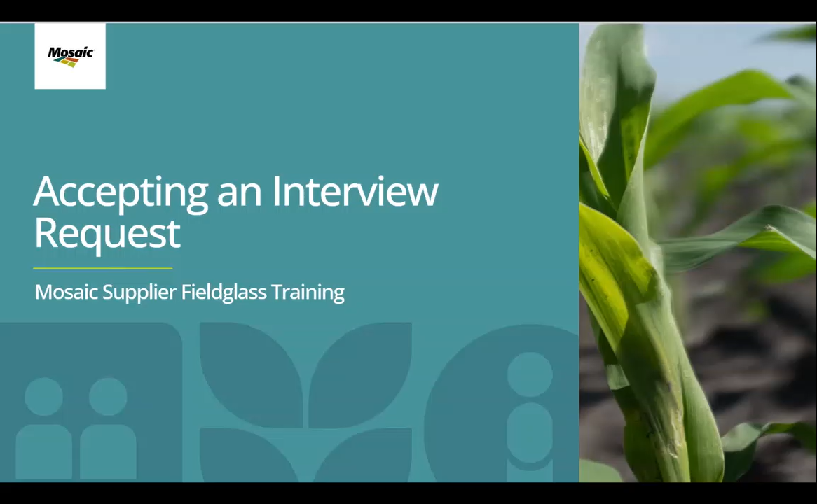
Accepting an Interview Request

Slide 4
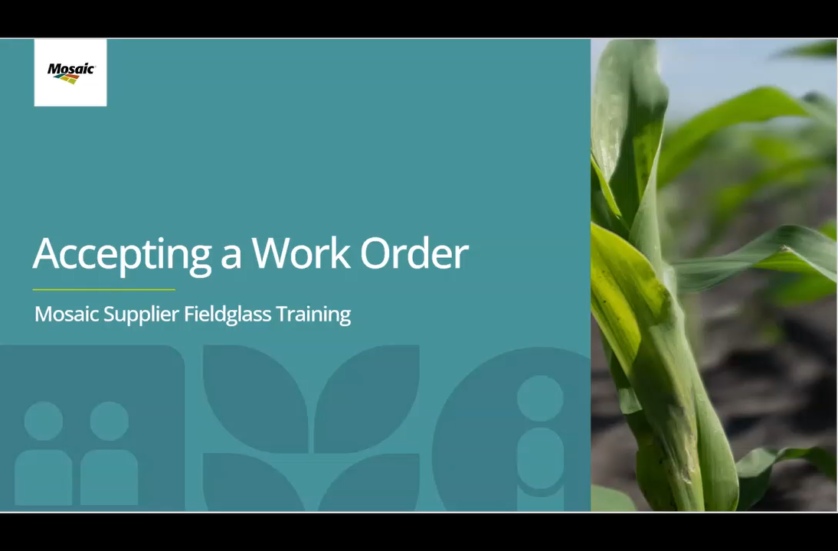
Accepting a Work Order

Slide 5
Thank you!
Questions? Contact ITContractorMgmt@Mosaicco.com

